Slide 1
Weekly Discovery Report 4
CycleSIGHT
Aiyana, Gloria, Farruh
CycleSIGHT: Because pain isn’t one-size-fits-all.

Slide 2
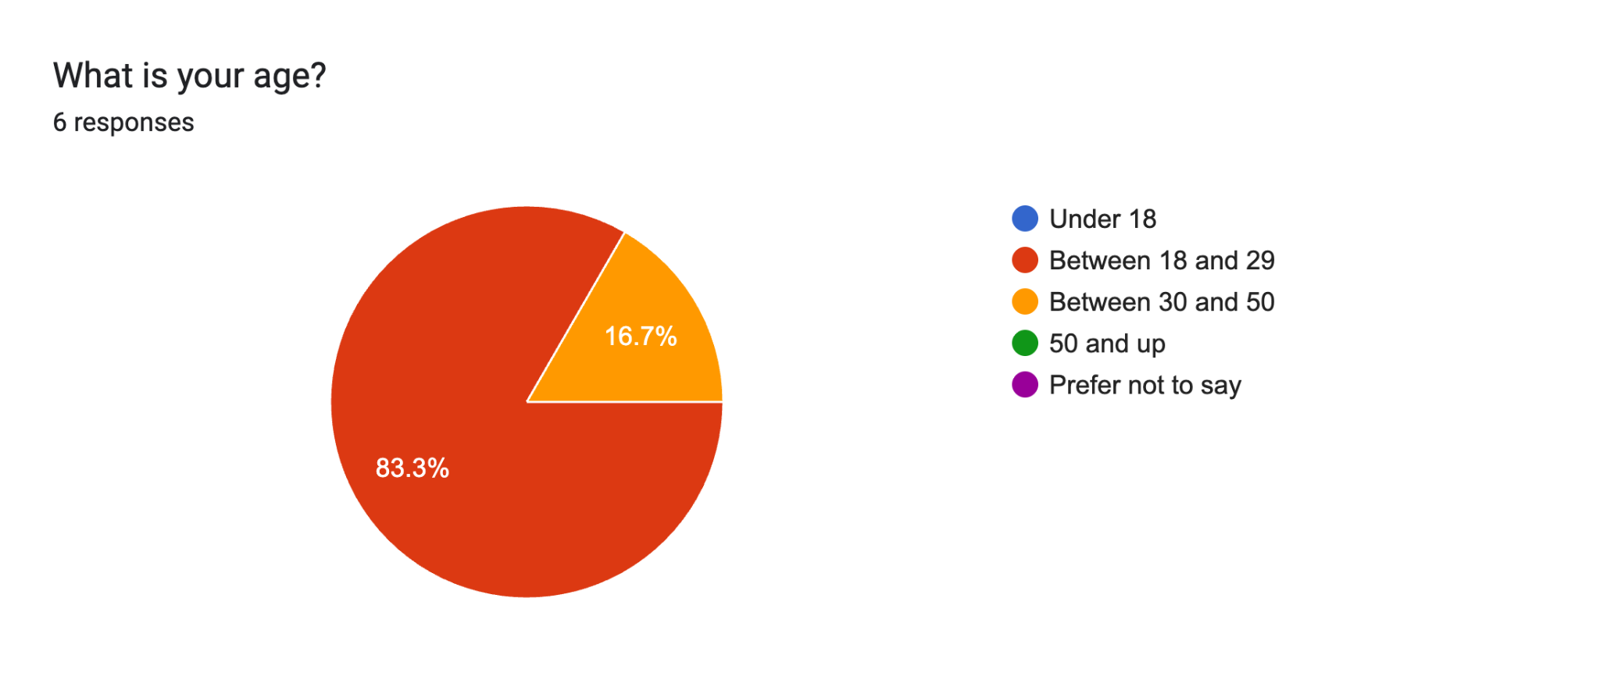
Q1.

Slide 3
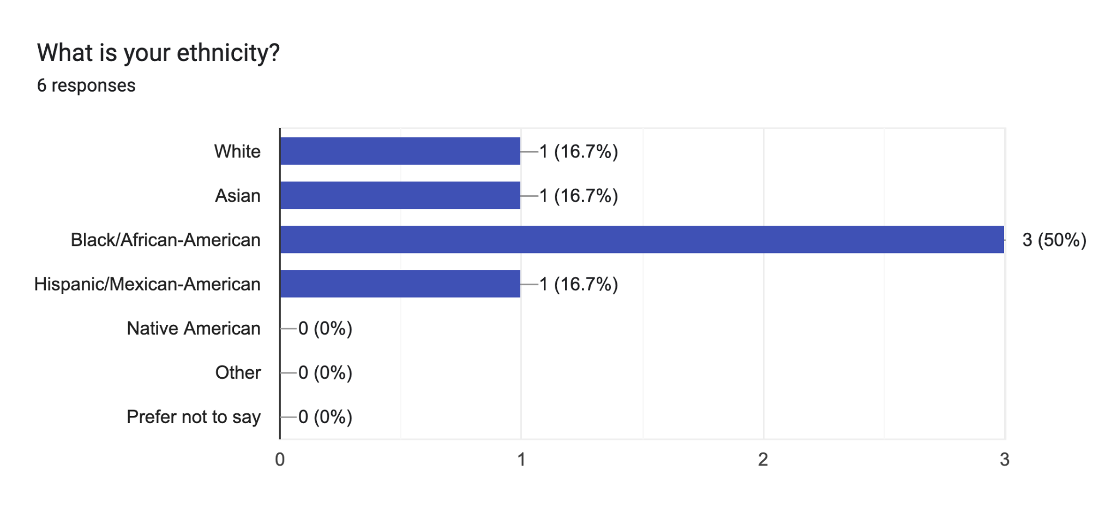
Q2.

Slide 4
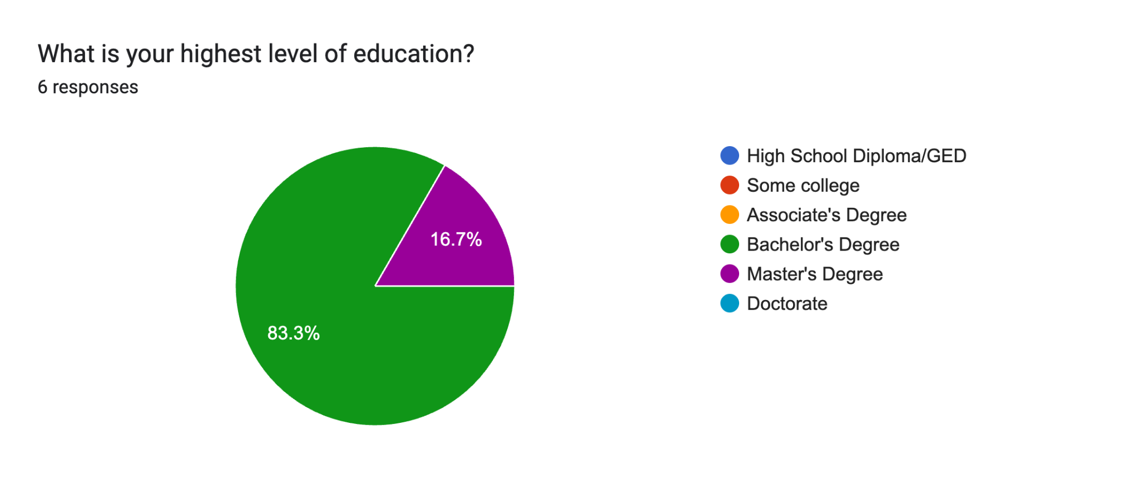
Q3.

Slide 5
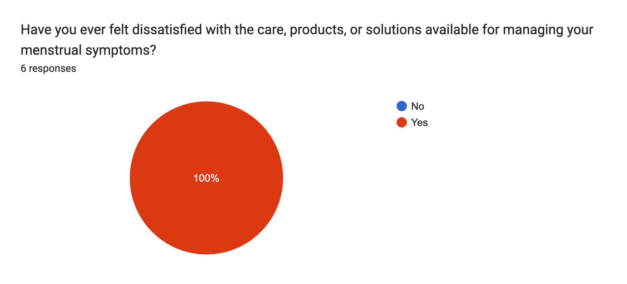
Q4.

Slide 6
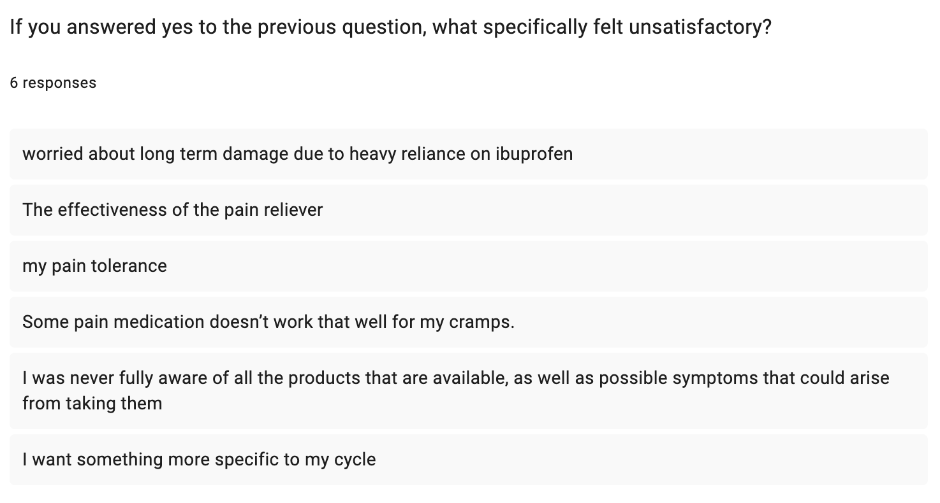

Slide 7
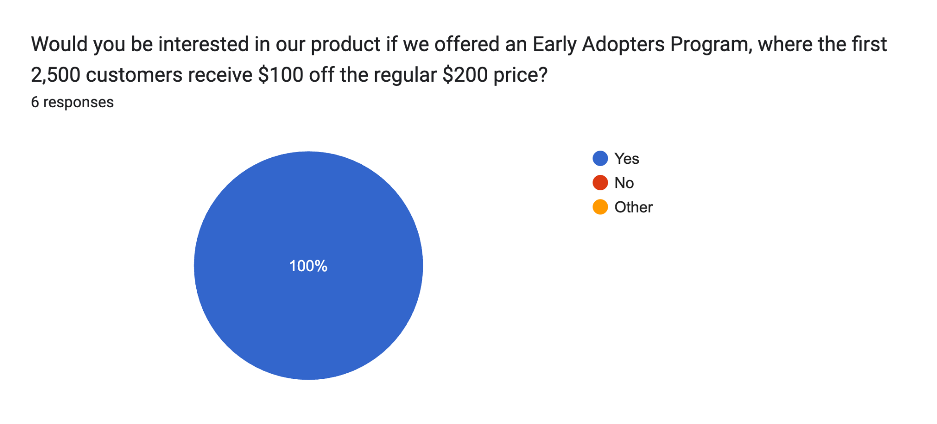
Q6.

Slide 8
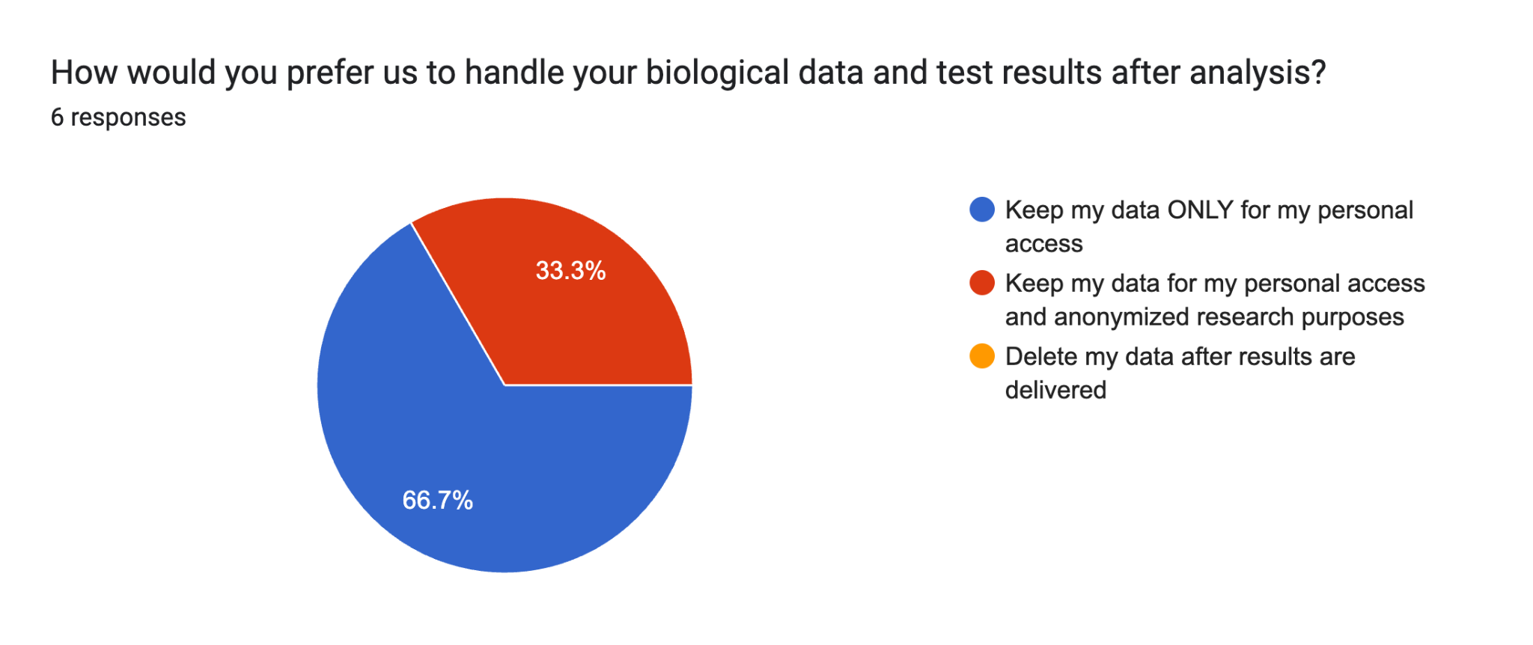
Q7.

Slide 9
Thank you.

